Slide 1
AI Tutorial Presentation – Level 1
ChatGPT
Date of Revision – 9/6/25

Slide 2
ChatGPT – Beginner-Level (What is ChatGPT)
Introduction to OpenAI's Conversational AI Model
Introduction
AI is revolutionizing human-computer interaction
ChatGPT is a leading AI chatbot developed by OpenAI
Goal: Understand what ChatGPT is, how it works, and its applications.
What is ChatGPT?
ChatGPT = Chat (Conversation) + GPT (Generative Pre-trained Transformer)
A language model that generates human-like text
Developed by OpenAI based on deep learning architecture
Can understand prompts, answer questions, generate content, and converse

Slide 3
ChatGPT – Beginner-Level (What is ChatGPT)
The Technology Behind ChatGPT
ChatGPT = AI chatbot by OpenAI.
Built on Transformer Architecture
Pre-trained on vast amounts of internet text
Fine-tuned for dialogue and task-specific conversations.
Versions: GPT-3, GPT-3.5, GPT-4, etc
How ChatGPT Works
Input Prompt or Prompt Box (User message)
Processing (Predicts next words based on context)
Response Area: ChatGPT replies
Generates Response (Human-like answer)
Regenerate, Copy, Edit buttons
It doesn’t “think” but predicts based on patterns in data.

Slide 4
ChatGPT – Beginner-Level (What is ChatGPT)
Key Capabilities
Answering Questions (Natural language understanding and generation)
Creative Writing (stories, poems)
Contextual memory (in some versions) and Summarizing Texts
Coding Assistance
Multilingual support and Language Translation
Role-playing Scenarios
Applications of ChatGPT
Customer Support Chatbots
Virtual Assistants (Writing Emails & Reports)
Content Creation & Brainstorming (Learning New Topics.)
Education & Tutoring (Creative Writing: Poems, Stories)
Programming Help (Coding Help & Debugging)
Research Summarization

Slide 5
ChatGPT – Beginner-Level (What is ChatGPT)
Limitations of ChatGPT
May generate incorrect or nonsensical answers.
Lacks true understanding or consciousness
Sensitive to prompt phrasing
Can reflect biases from training data
Future of ChatGPT
More accurate and specialized models.
Integration with tools (search, code, design).
AI-Human collaboration in workplaces
Continuous improvements in safety and ethics

Slide 6
ChatGPT – Beginner-Level (What is ChatGPT)
Conclusion
ChatGPT is a powerful conversational AI tool.
Transforming industries through human-like interactions
Start with simple prompts and explore its capabilities
Review responses critically. Always verify factual information
Practice makes perfect—experiment and learn.
Responsible usage is key to leveraging its potential.
Ethical Considerations
Use ChatGPT as a collaborator, not a replacement
Stay updated with new features.
Questions?
Let’s discuss how ChatGPT can be useful to you.

Slide 7
ChatGPT – Beginner-Level (Getting Started …)
Beginner’s Guide to Using AI Conversations
Why Use ChatGPT?
Instant answers to questions
Helps with writing, coding, summarizing, and more
Great for brainstorming ideas.
Available 24/7 as a virtual assistant.
How to Access ChatGPT
Go to chat.openai.com
Sign up for an OpenAI account (free or Plus plan)
Log in and start chatting

Slide 8
ChatGPT – Beginner-Level (Getting Started …
Versions and Improvements
GPT-3: Released in 2020.
GPT-3.5: Improved speed and reliability.
GPT-4: More accurate, creative, and safe.
GPT-4o: Multimodal – supports text, vision, and audio input/output.

Slide 9
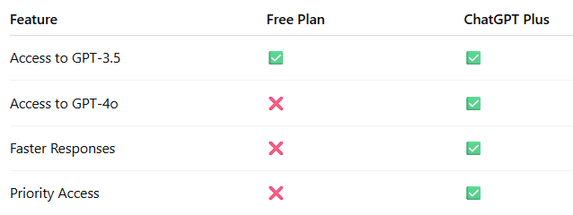
ChatGPT – Beginner-Level (Getting Started …)
Free vs. Plus Plan

Slide 10
ChatGPT – Beginner-Level (Getting Started …)
Common Mistakes to Avoid
Vague prompts → Confusing answers.
Expecting 100% accuracy
Ignoring biases or ethical considerations
Not experimenting with prompt styles.

Slide 11
ChatGPT – Beginner-Level (Prompt Engineering)
Advanced Strategies to Get the Best Out of Language Models
What is Prompt Engineering?
Designing effective inputs for AI models
Helps guide tone, structure, and accuracy
Crucial for AI writing, coding, summarizing, and reasoning tasks
Categories of Techniques
Role-based prompting
Format and structure control
Step-by-step reasoning
Examples (few-shot)
Constraints and boundaries
Multi-turn (contextual chaining)

Slide 12
ChatGPT – Beginner-Level (Prompt Engineering)
Chain-of-Thought Prompting
Prompt model to show reasoning steps:
Example: “Explain step-by-step how the water cycle works.”
Great for math, logic, complex tasks
Helps improve accuracy and interpretability
Few-shot Learning
Give examples to guide output style
Translate English to French:
Hello → Bonjour
Goodbye → Au revoir
Thank you →

Slide 13
Prompt Engineering Techniques
Applying Constraints
Guide the output clearly:
“Use no more than 50 words”
“Exclude technical jargon”
“Make it rhyme / Alliteration / Haiku form”
“Only return the final answer, no explanation”
Iterative Prompting & Refinement
Evaluate model's response
Adjust tone, clarity, specificity
Chain results with follow-ups:
“Now turn this summary into an email”

Slide 14
ChatGPT – Beginner-Level (Prompt Engineering)
Role-based Prompting
Put the model in a role:
“You are a senior data scientist…”
“Act as a therapist specializing in CBT…”
Why it works: Sets context + expectations
Output Formatting Techniques
Force structure:
“Respond in JSON format with fields: title, summary, tags”
“Use bullet points and max 10 words per point”
Also useful for API and automation workflows

Slide 15
ChatGPT – Beginner-Level (Prompt Engineering)
Prompt Templates
Reusable scaffolds for consistency:
Act as [role] and [task], using [style]…”
“List [n] [things] about [topic]…”
Ideal for automation, coding tasks, and team workflows
Prompt Debugging Tips
If model misbehaves:
Make prompt more explicit
Add output examples
Reduce ambiguity
Add format constraints or delimiters (``` or """)

Slide 16
ChatGPT – Beginner-Level (Prompt Engineering)
Real-World Use Case Examples
Code generation with specs
Customer support reply formatting
Data extraction from text into CSV/JSON
Creative writing with tone/mood constraints
Tools & Resources
PromptHero (https://prompthero.com)– Prompt examples
FlowGPT (https://flowgpt.com)– Prompt sharing
OpenAI Cookbook (openaiopenai-cookbook)
Prompt Engineering GitHub:
dair-ai/Prompt-Engineering-Guide

Slide 17
ChatGPT – Beginner-Level (Prompt Engineering)
Final Thoughts
✅ Prompt engineering is a design skill
✅ Experiment, iterate, and learn from outputs
✅ Combine techniques for best results
✅ Stay updated with new LLM features

Slide 18
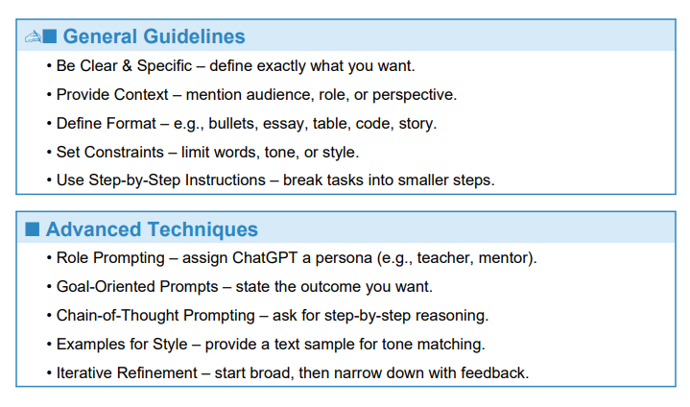
ChatGPT Prompt Writing Guidelines

Slide 19
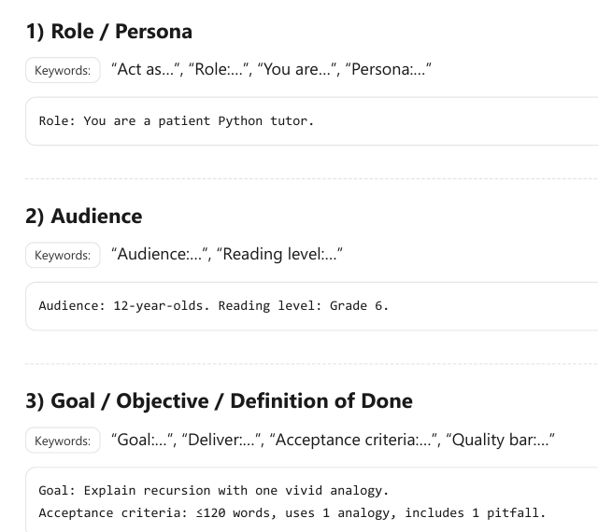
Prompting Keywords + Examples

Slide 20
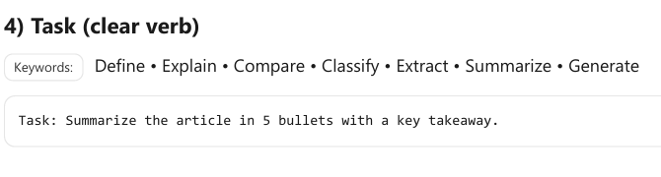
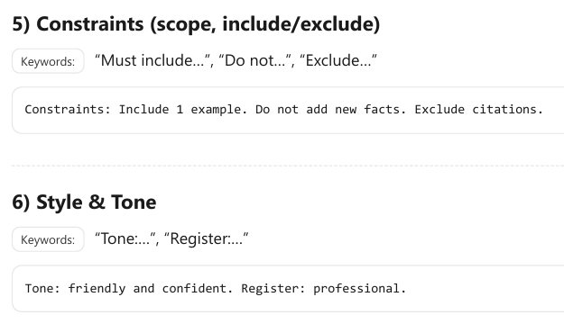
Prompting Keywords Examples Continued

Slide 21
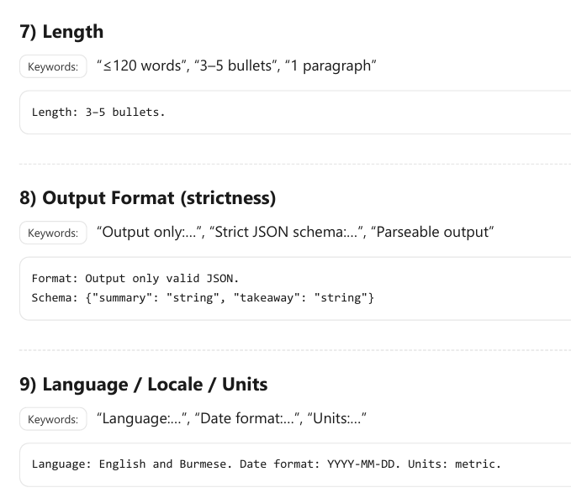
Prompting Keywords Examples Continued

Slide 22
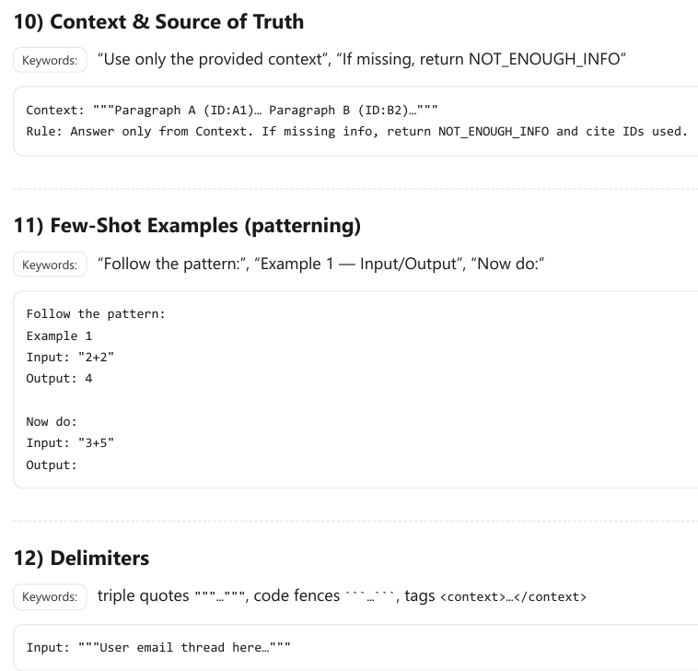
Prompting Keywords Examples Continued

Slide 23
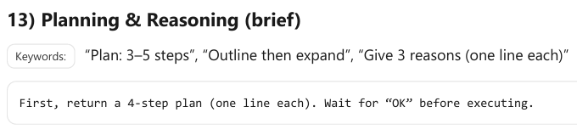
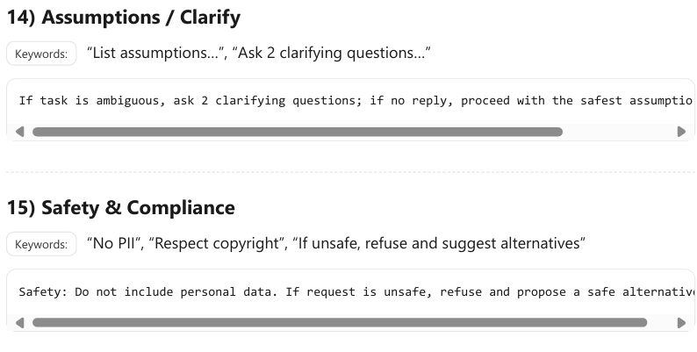
Prompting Keywords Examples Continued

Slide 24
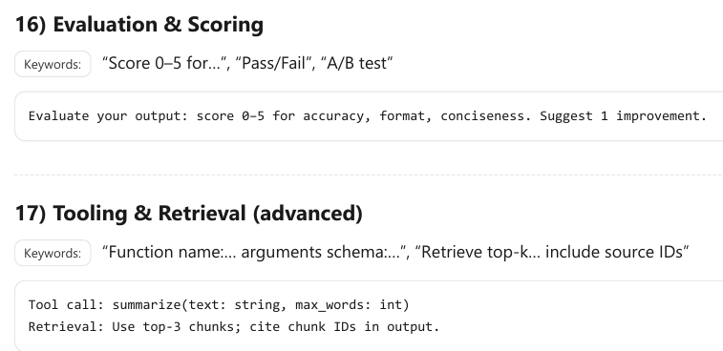
Prompting Keywords Examples Continued

Slide 25
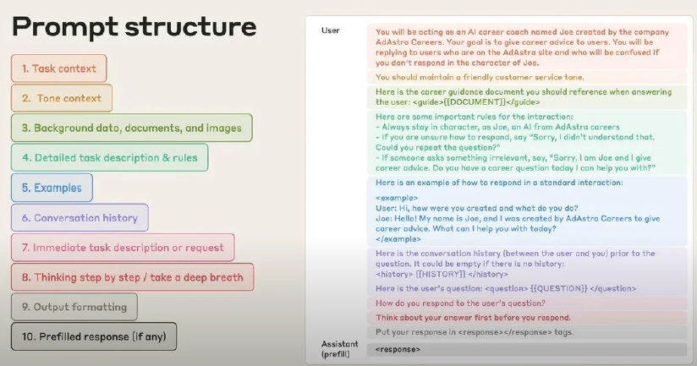
Prompt Template

